Slide 1
1st Semester IOT Progression
Where Are we?
Hamza: I am creating a smart washer/dryer based off an Arduino that can be controlled via an app. It matters to me because it can help make peoples busy lives a little easier and more streamlined. I’ve changed up the idea a bit but it is very similar to what I had started.
I need to make sure that I stay on task during my course days. I will definitely need some support. Most likely from Billy and Mo.
Zach:
I’m making a Servo Skull from Warhammer 40k that has several built in sensors to take in and upload it to the cloud.
It matters to me due to how it is my first real foray into robotics.
The first major success includes constructing the proper circuit for the temperature sensors.
Julio:
My project is to create a mailbox sensor that would notify me once the mail has came in!
This matters to me because it shows me that I’m trying out new things and get to the good habit of finishing big projects
I’m currently deciding if I should create a website dedicated to receiving electronic notifications through FireBase.
Throughout the semester, I was able to create the schematic and circuit of my buzzer.
Maria:
I’m creating a small robot capable of organizing one’s messy workplace. It will work with sensors to navigate and will be programmed to pick up any misplaced objects.
It matters to me because it will demonstrate my skills in the fields of Robotics and Computer Science. Also think the idea is cool!
A success I’ve had was recollecting the past C++ code I worked on in the past.
No major changes so far.

Slide 2
1st Semester IOT Progresion
Obstacles and challenges
Zach:
The only challenge so far was the learning the proper code, even then I was able to work backwards from tutorials
I don't really have any challenges or blocks to speak of
Allies of mine include the Arduino project book, Mo, and Billy
Julio:
I definitely still can’t picture what kind of code would allow me to communicate from point A (Arduino wifi) to point B (Arduino uno)
A course or a instructor that can walk me through the process could be super helpful
My allies are Mo, ChatGPT and Youtube
Maria
I’ve had no major challenges so far.
I have so difficulties relearning C++
Allies of mine are ChatGPT, Replit, Youtube, and some school teachers
Hamza: There were some slight challenges such as me trying to figure out certain concepts. With the help of Billy and Mo, I overcame many of these with their help, and i’ve used those to enhance my learning.

Slide 3
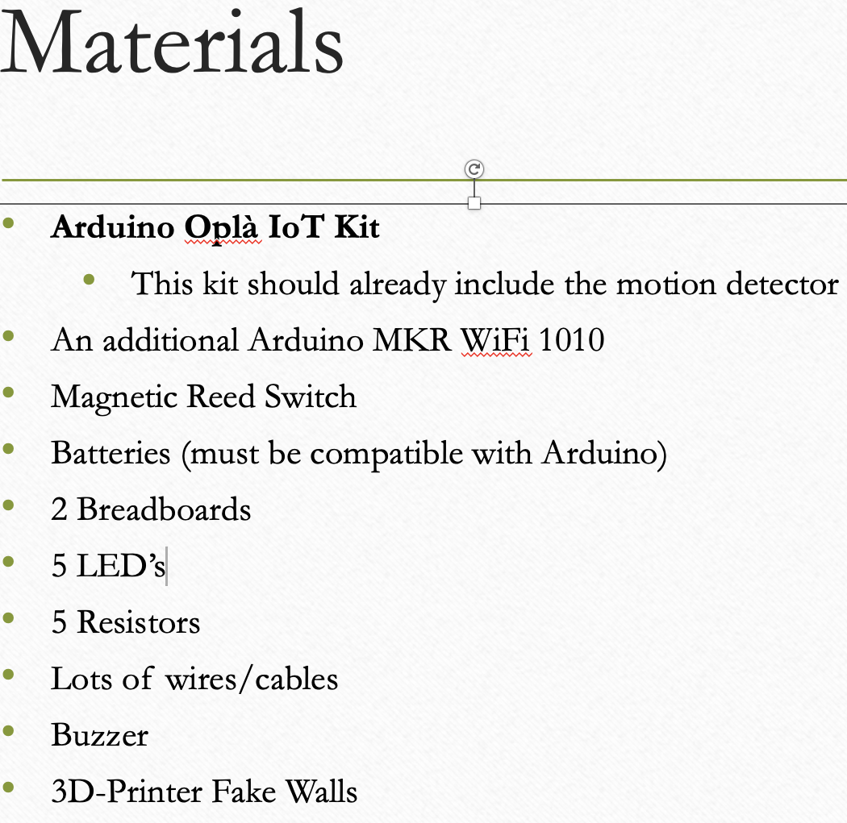
1st Semester IOT Progresion
Adjustments & Improvements
Zach:
I’ll meet the goal by having a clear plan of attack.
The most support I will need is for when I ask for assistance from specific people.
Julio:
Still researching if I can utilize an arduino one instead.
I would definitely need some support in terms of checking-in with somebody that is making sure that I’m in the right track and provides answers to my questions.
Ofc nobody is perfect but bringing someone with IOT experience could not only be helpful for me but for the rest of the crew to make our goals more attainable and realistics
Maria:
I’ll plan check-ins to remind myself where I should be at.
I currently need no support.
Hamza: I need to adjust my materials to what I have right now.

